Slide 1

Modelling Anthropogenic Climate Change
By Thomas Davies
Supervised by: Craig P. Testrow & Richard J. Wilman
Department of Physics, Durham University

Slide 2
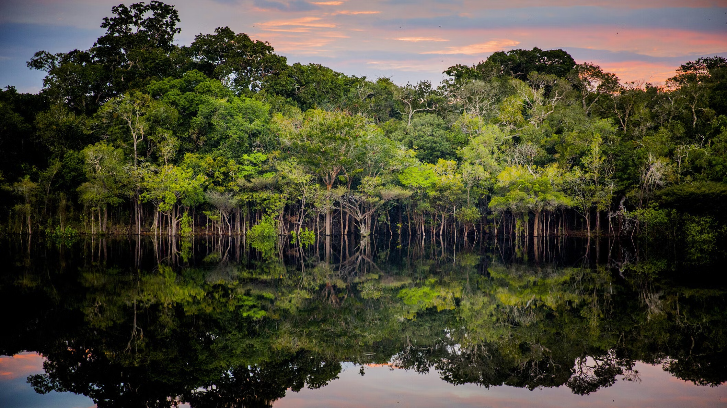
Seminar Outline
Project Objective
Q & A
The Climate Crisis
Temperature Forecasts
The Climate Model
(iStock / Anna Carolina Negri)

Slide 3
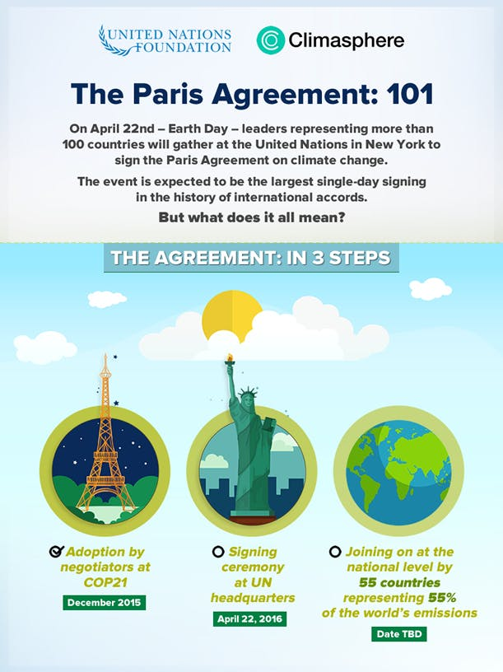
Project Objective
The Paris Agreement
“National climate action plans remain insufficient to limit global temperature rise to 1.5 degrees Celsius” – IPCC 2023 Report
The Project Objective
Understand the climate implications of various emission scenarios, aiding in the selection of a new Paris agreement.
(unfoundation.org)

Slide 4
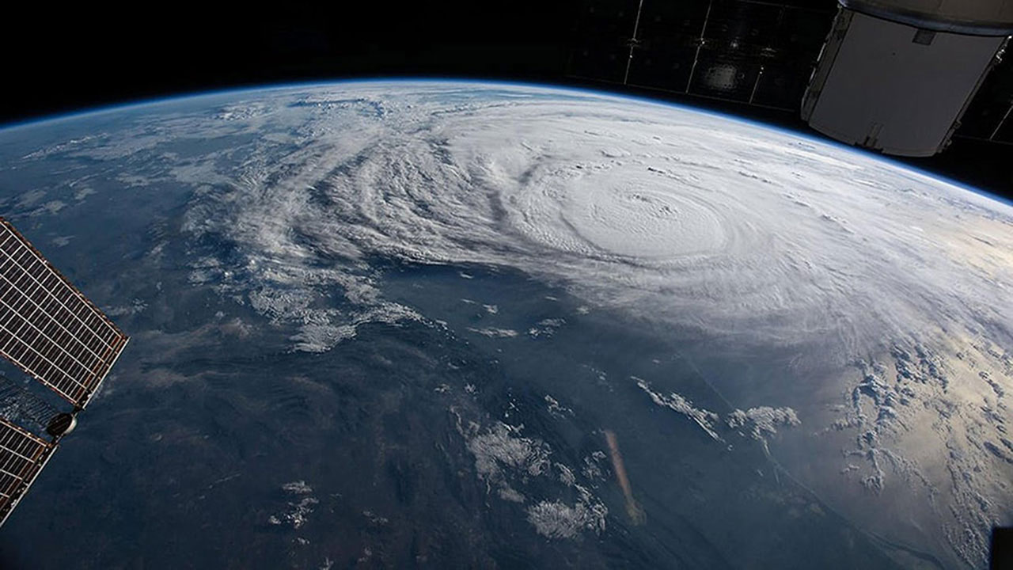
The Climate Crisis
(issnationallab.org)

Slide 5
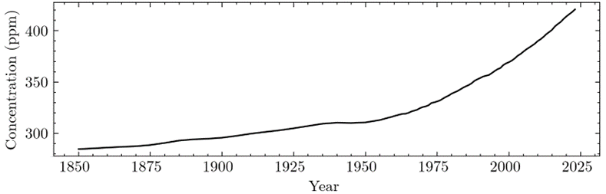
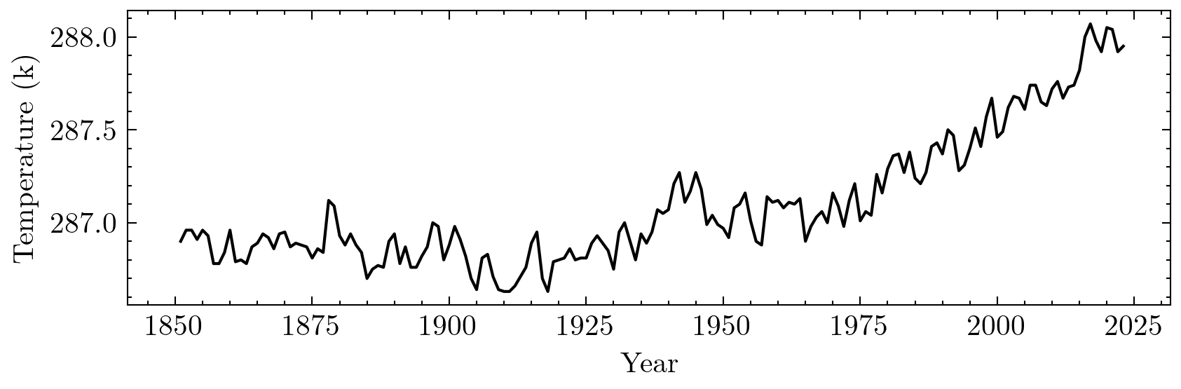
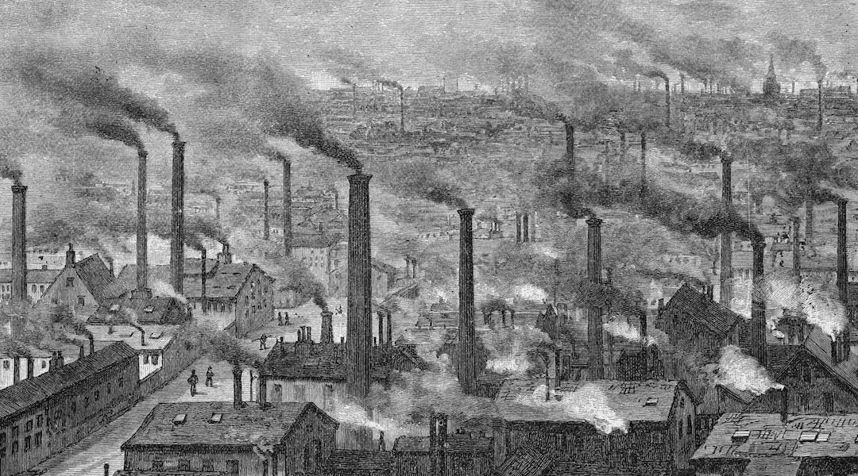
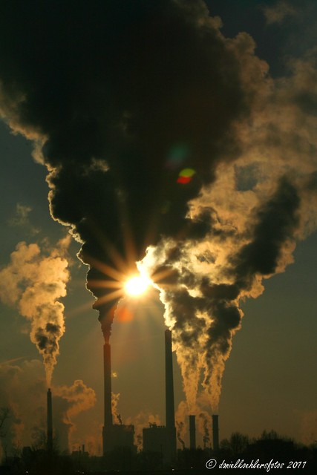
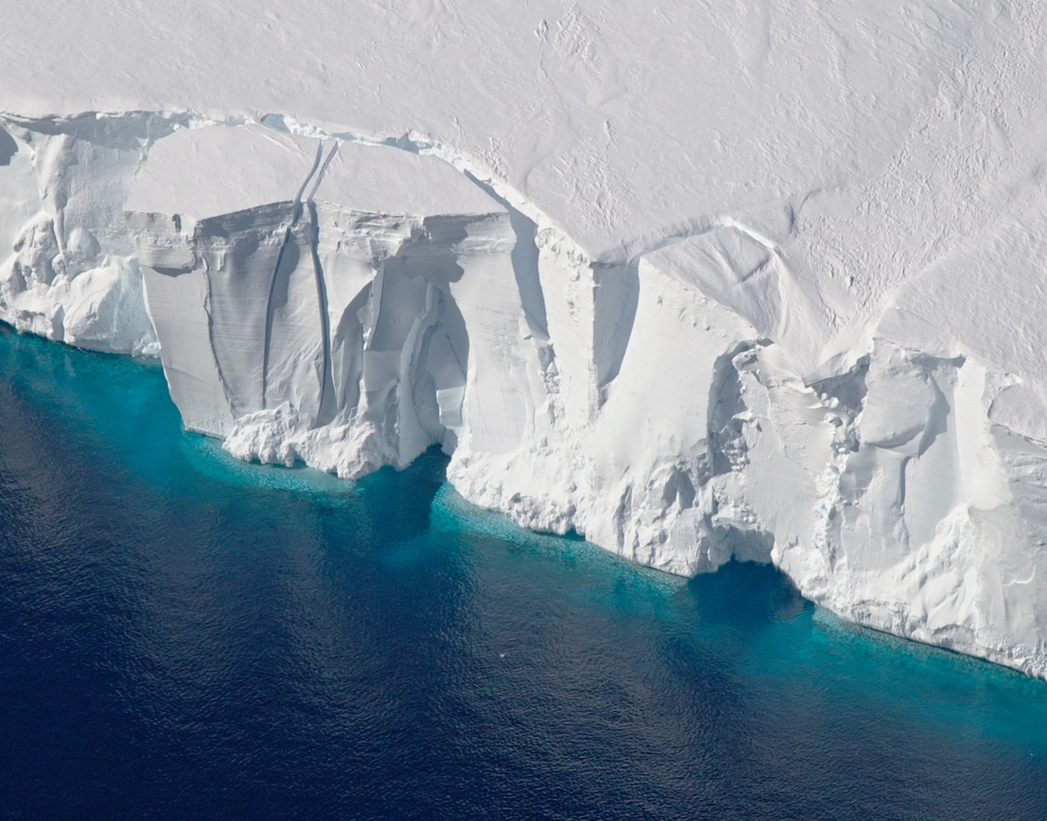
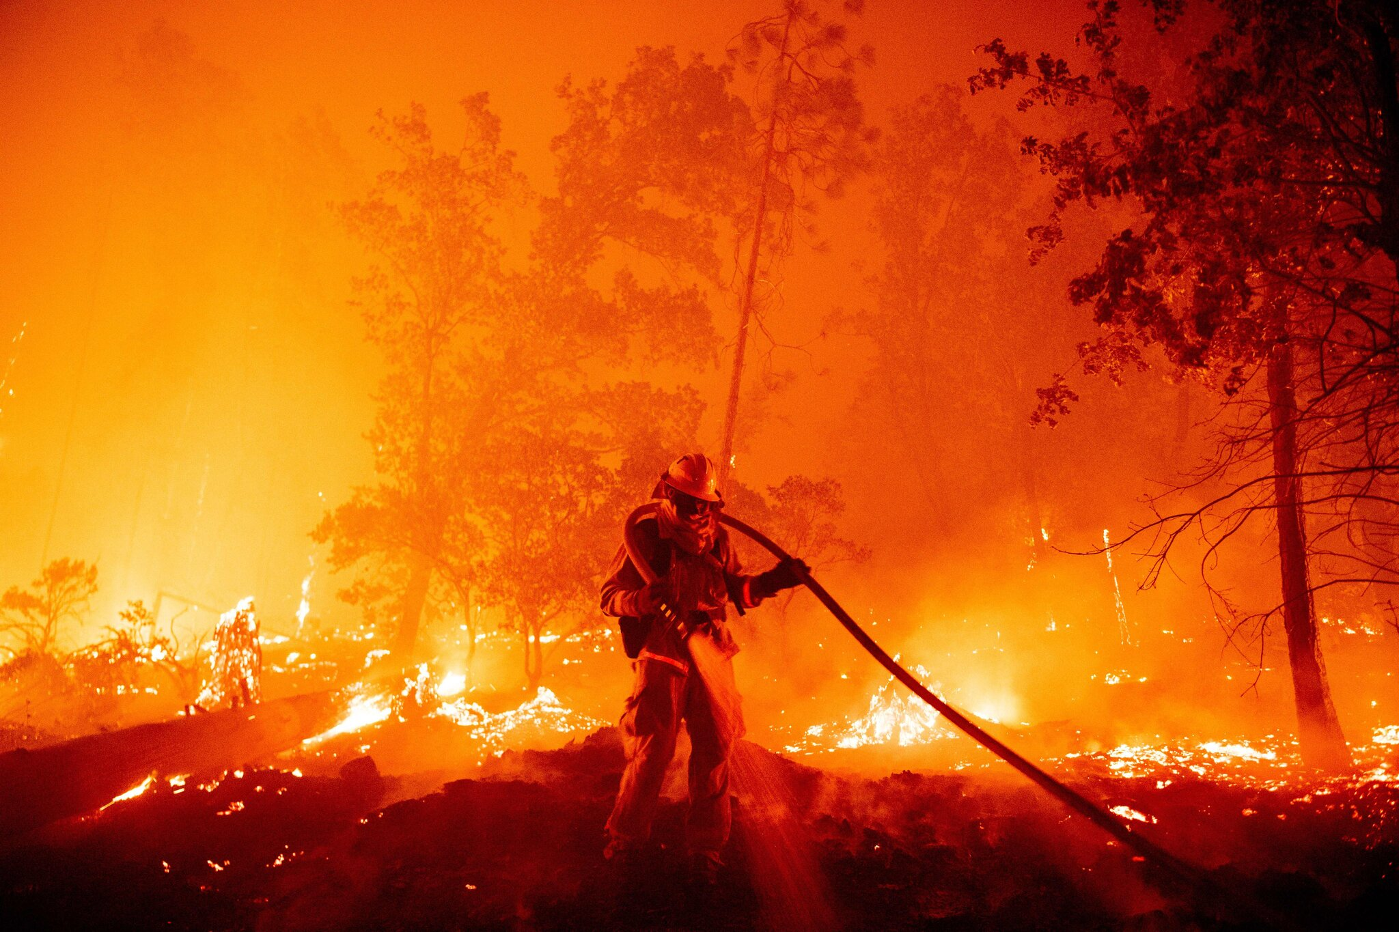
The Climate Crisis
Atmospheric CO2 Trend
Global Temperature Trend
(merchantsandmechanics.com)
(flickr.com / Daniel Kohler)
(NASA)
(Josh Edelson/AFP/Getty Images)

Slide 6
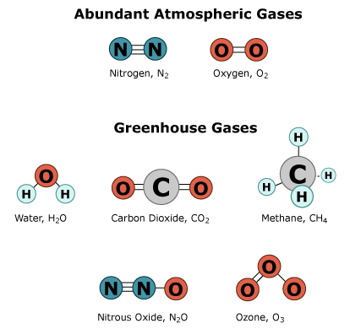
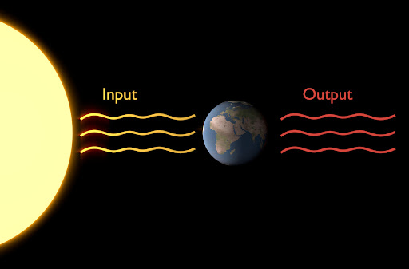
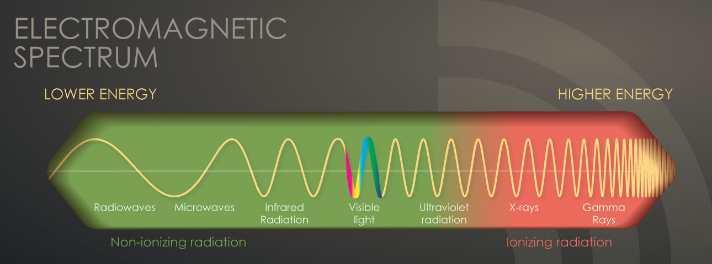
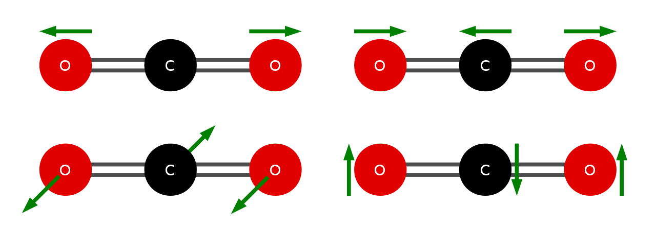
The Greenhouse effect
What is a greenhouse gas?
How do they effect global temperature?
(cdn.imo.org)
(Markus Nielbock)
(integrate.mutz.science, cdc.gov)

Slide 7
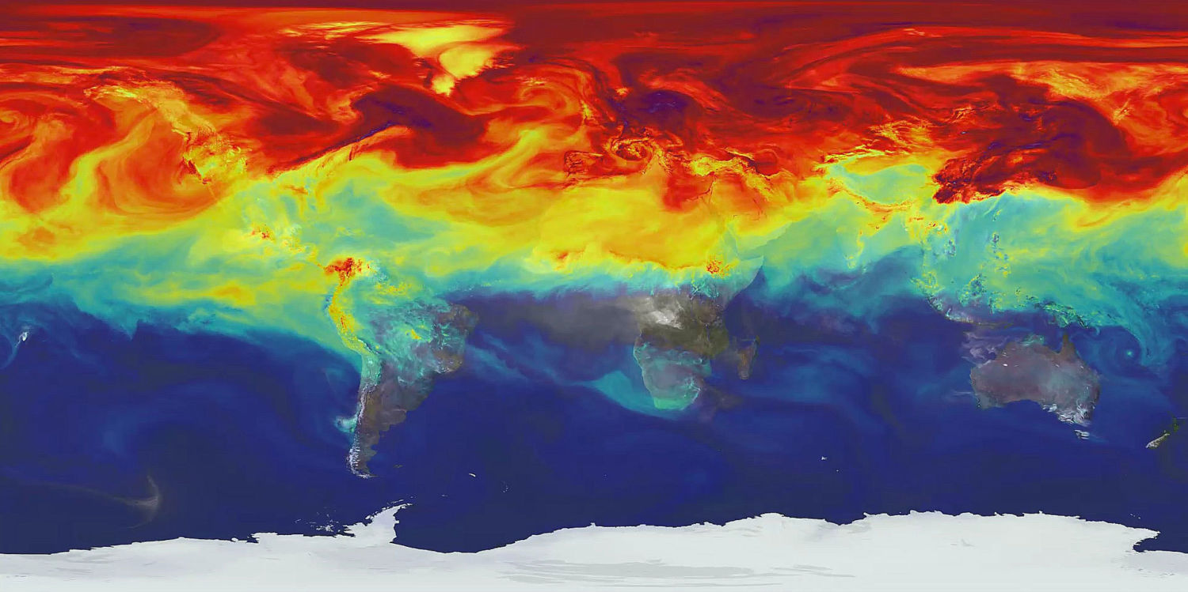
The Climate Model
(NASA)

Slide 8
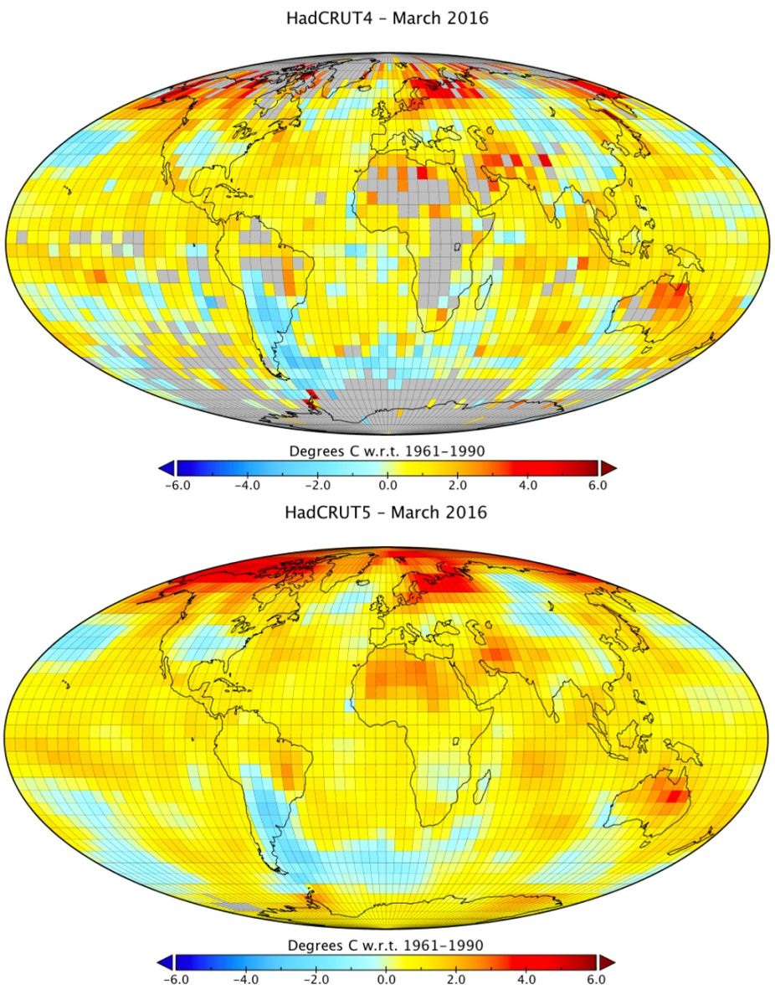
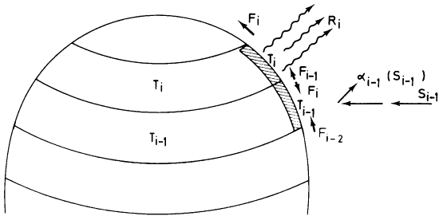
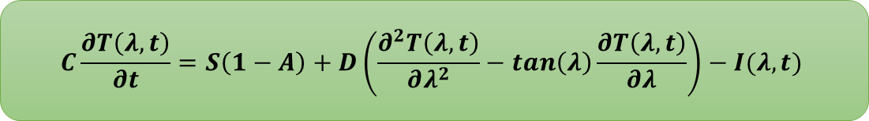
Climate Model
One-Dimensional Energy Balance Model
$$C\frac{∂T\left(λ, t\right)}{∂t}=S\left(1−A\right)+D\left(\frac{∂^{2}T\left(λ, t\right)}{∂λ^{2}}−\tan\left(λ\right)\frac{∂T\left(λ, t\right)}{∂λ}\right)−I(λ,t)$$
(psu.edu)
(climatedataguide.ucar.edu)

Slide 9
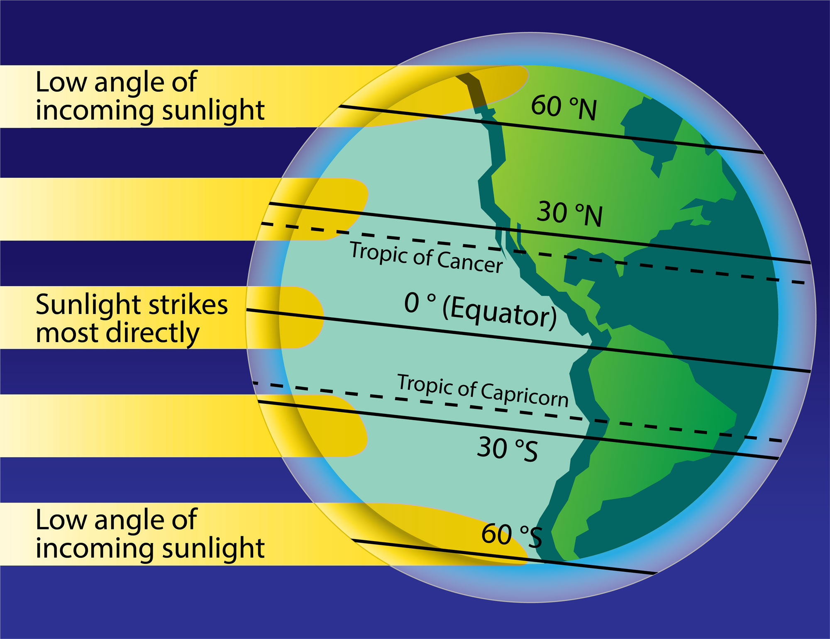
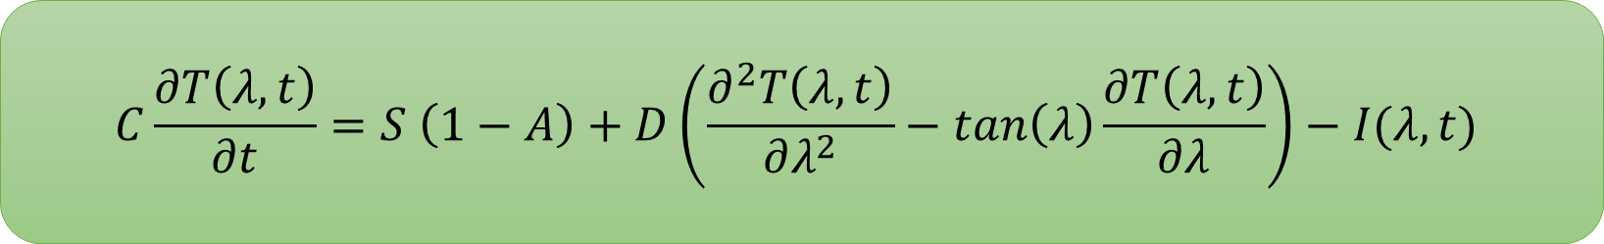
Diurnal Solar Flux
$$C\frac{∂T\left(λ, t\right)}{∂t}=S \left(1−A\right)+D\left(\frac{∂^{2}T\left(λ, t\right)}{∂λ^{2}}−\tan\left(λ\right)\frac{∂T\left(λ, t\right)}{∂λ}\right)−I(λ,t)$$
Diurnal Solar Flux (S)
Solar radiation intensity hitting the surface
Averaged over 24 hours
(berkeley.edu)

Slide 10
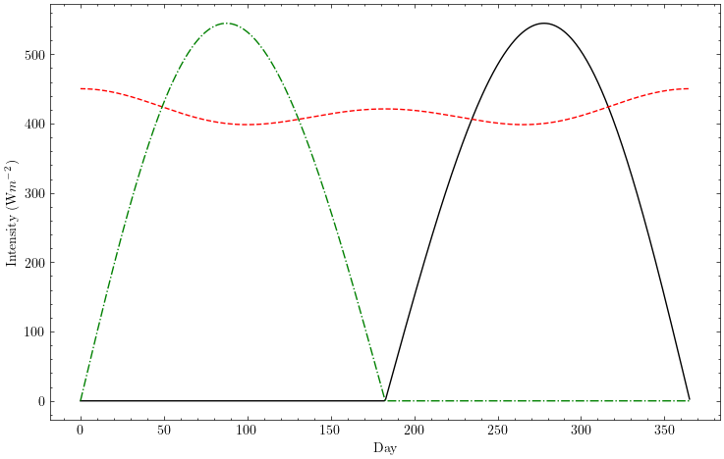

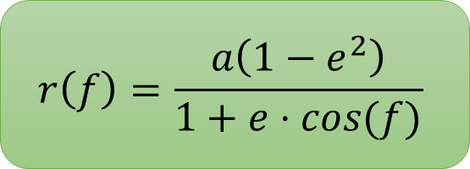

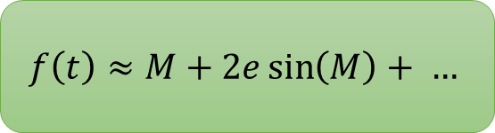
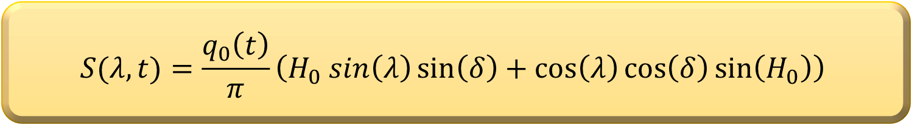
Diurnal Solar Flux
How do we calculate $S$?
$$f\left(t\right)≈M+2e\sin\left(M\right)+ …$$
$$r\left(f\right)=\frac{a\left(1−e^{2}\right)}{1+e⋅cos(f)}$$
$$q_{0}\left(t\right)=\frac{L_{sol}}{4π r^{2}}$$
$$S(λ,t)=\frac{q_{0}\left(t\right)}{π}\left(H_{0} sin\left(λ\right)\sin\left(δ\right)+\cos\left(λ\right)\cos\left(δ\right)\sin\left(H_{0}\right)\right)$$

Slide 11
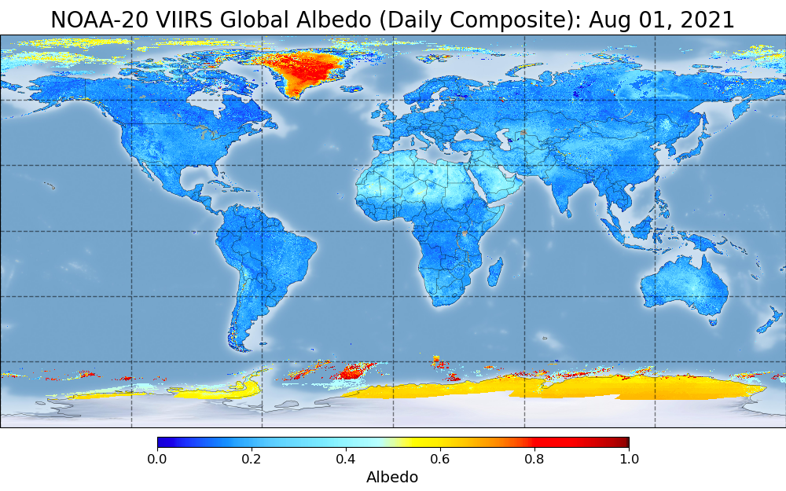
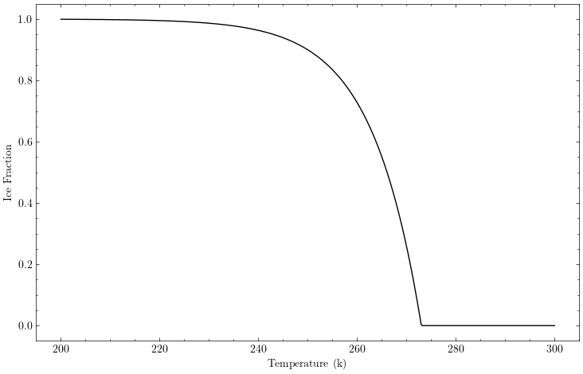
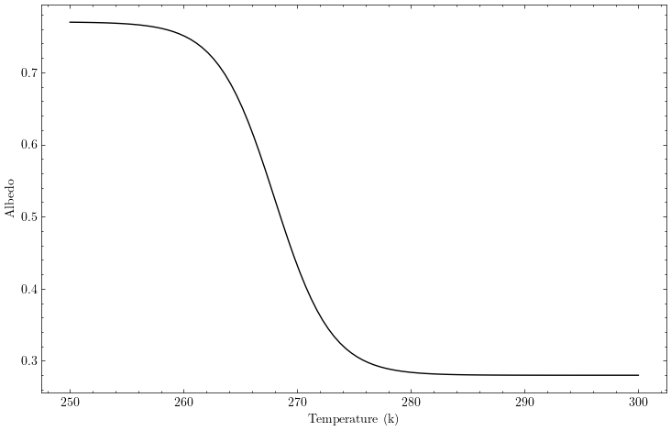
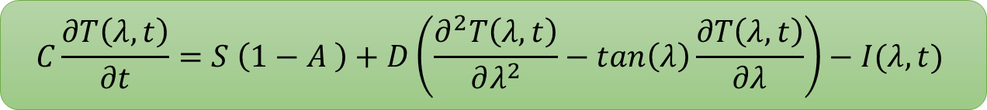

Surface Albedo
$$C\frac{∂T\left(λ, t\right)}{∂t}=S \left(1−A \right)+D\left(\frac{∂^{2}T\left(λ, t\right)}{∂λ^{2}}−\tan\left(λ\right)\frac{∂T\left(λ, t\right)}{∂λ}\right)−I(λ,t)$$
$$A\left(T\right)=0.525 −0.245⋅tanh⁡(0.2T −53.6)$$
(noaa.gov)

Slide 12
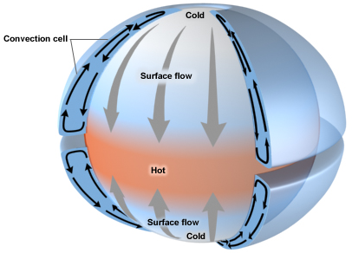
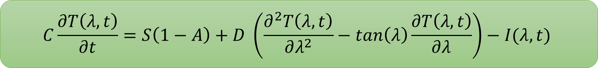
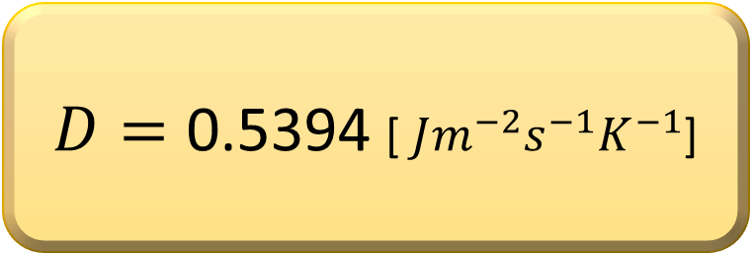
Horizontal Transport
$$C\frac{∂T\left(λ, t\right)}{∂t}=S\left(1−A\right)+D \left(\frac{∂^{2}T\left(λ, t\right)}{∂λ^{2}}−\tan\left(λ\right)\frac{∂T\left(λ, t\right)}{∂λ}\right)−I(λ,t)$$
$D=\text{0.5394}$ [ $Jm^{−2}s^{−1}K^{−1}$]
(springer.com)

Slide 13
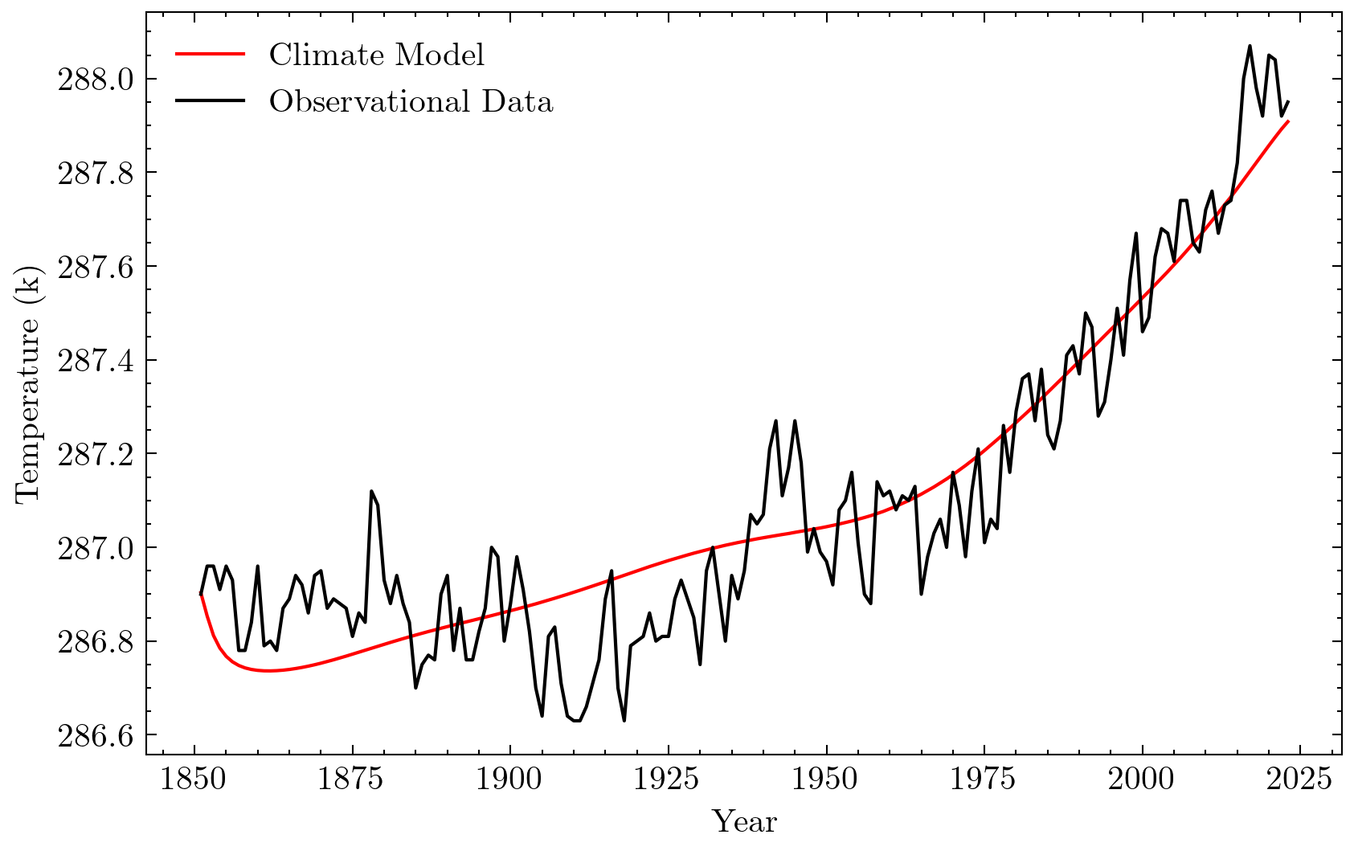
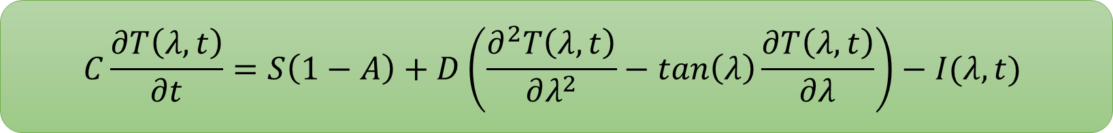
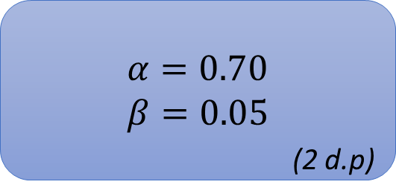
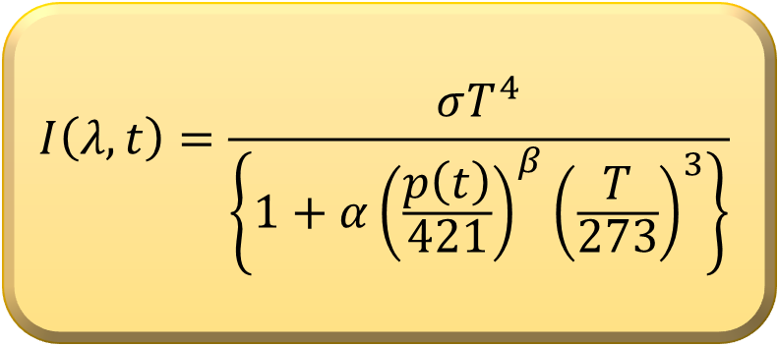
Infrared Cooling
$$C\frac{∂T\left(λ, t\right)}{∂t}=S\left(1−A\right)+D\left(\frac{∂^{2}T\left(λ, t\right)}{∂λ^{2}}−\tan\left(λ\right)\frac{∂T\left(λ, t\right)}{∂λ}\right)−I(λ,t)$$
$$I\left(λ, t\right)=\frac{σT^{4}}{\left\{1+α{\left(\frac{p\left(t\right)}{421}\right)}^{β}{\left(\frac{T}{273}\right)}^{3}\right\}}$$
$α=0.70$
$β=0.05$
(2 d.p)

Slide 14
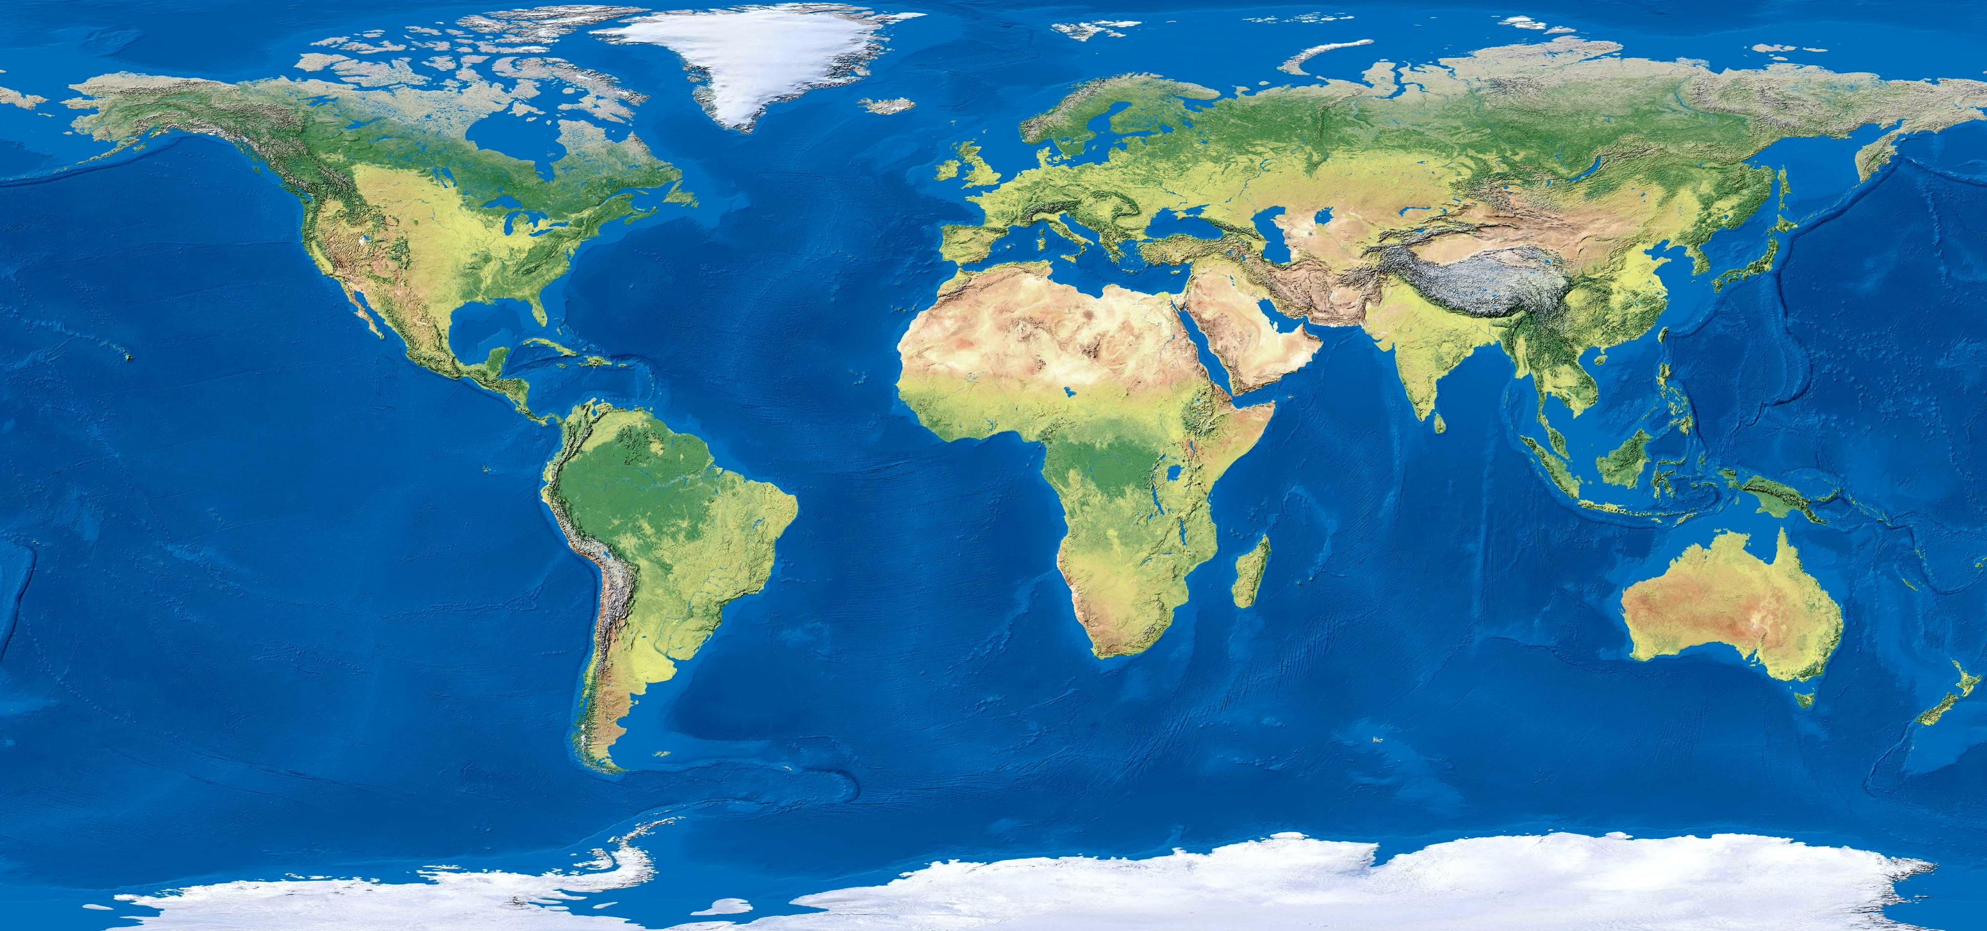
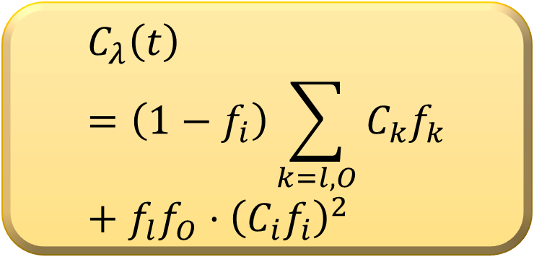
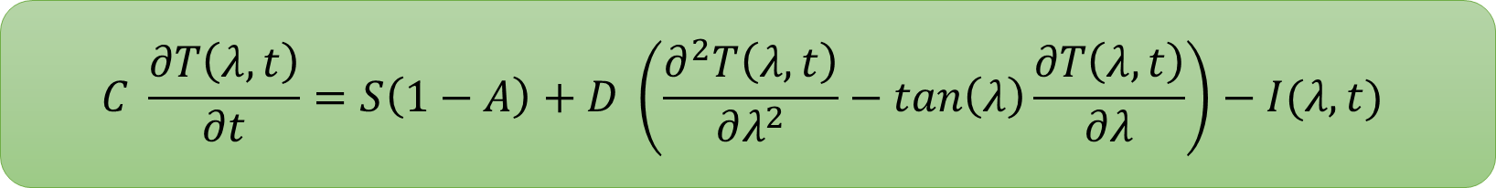
Heat Capacity
$$C \frac{∂T\left(λ, t\right)}{∂t}=S\left(1−A\right)+D \left(\frac{∂^{2}T\left(λ, t\right)}{∂λ^{2}}−\tan\left(λ\right)\frac{∂T\left(λ, t\right)}{∂λ}\right)−I(λ,t)$$
$$C_{λ}\left(t\right)=\left(1−f_{i}\right)\sum_{k=l,O}{C_{k}f_{k}}+{f_{l}f_{O}⋅\left(C_{i}f_{i}\right)}^{2}$$
(surfertoday.com)

Slide 15
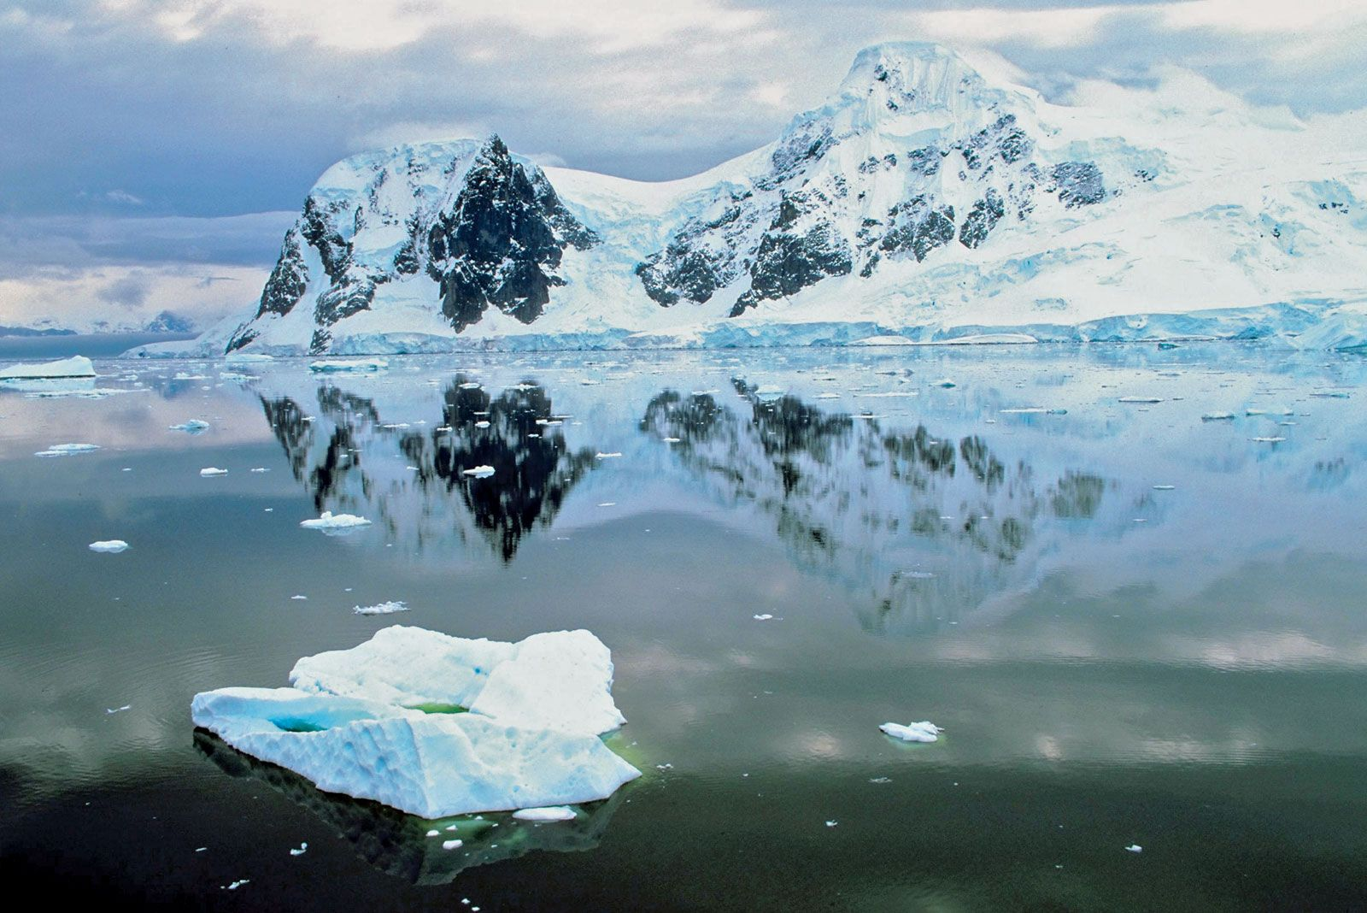
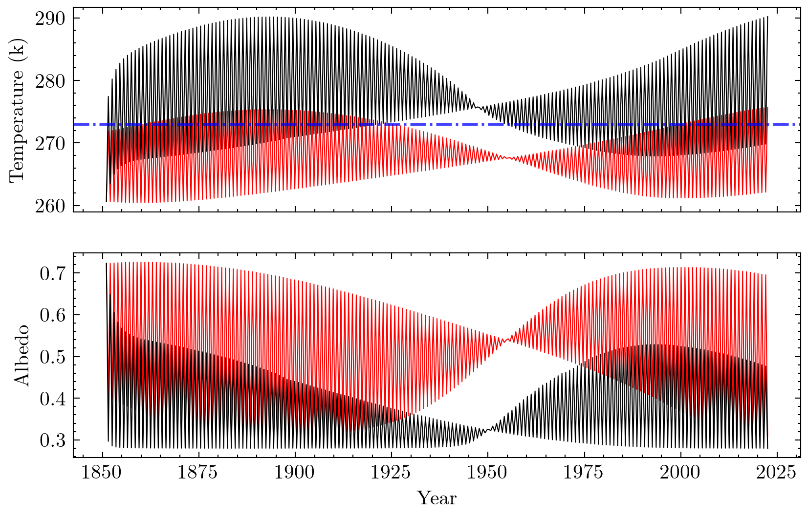

Antarctica
Why does Antarctica need special treatment?
Antarctica sits 2500m above sea-level
Overestimating energy absorbed
(surfertoday.com)
Lapse-rate:
$$T^{′}=T −6.5 Δh$$
More accurate albedo profile

Slide 16
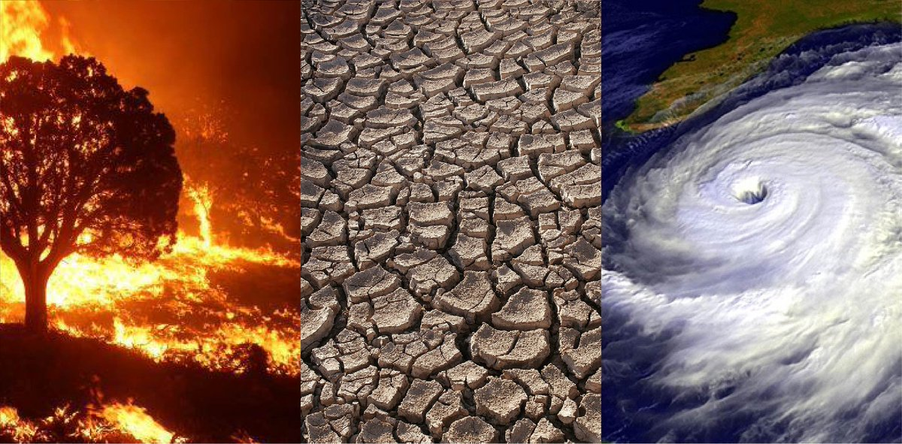
Temperature Forecasts
(NASA)

Slide 17
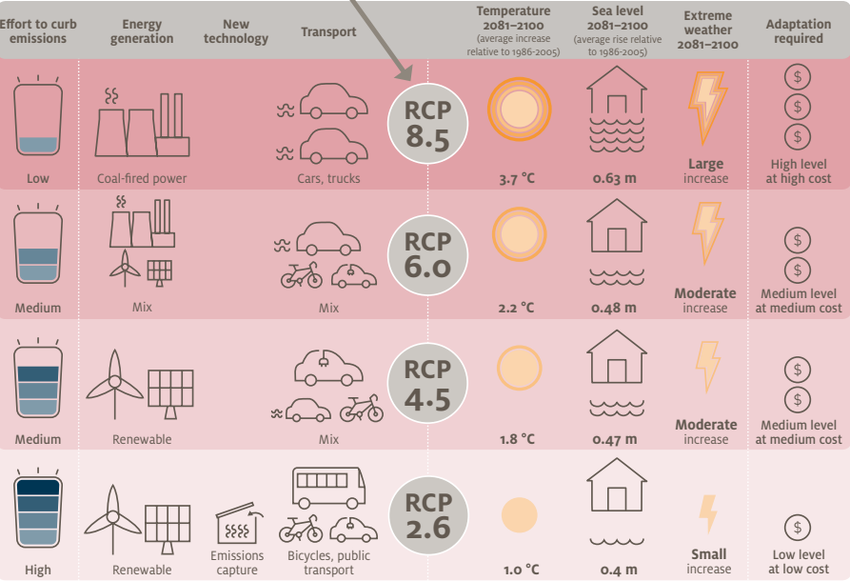
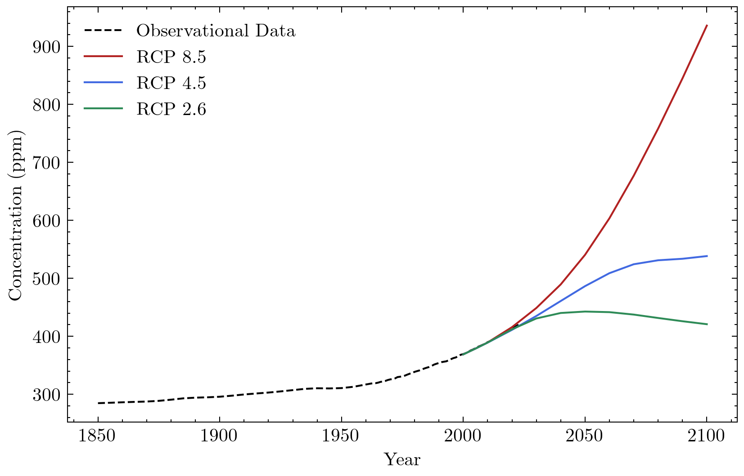
Representative Concentration Pathways (RCPs)
Projecting Atmospheric CO2 Levels
(coastadapt.com.au)

Slide 18
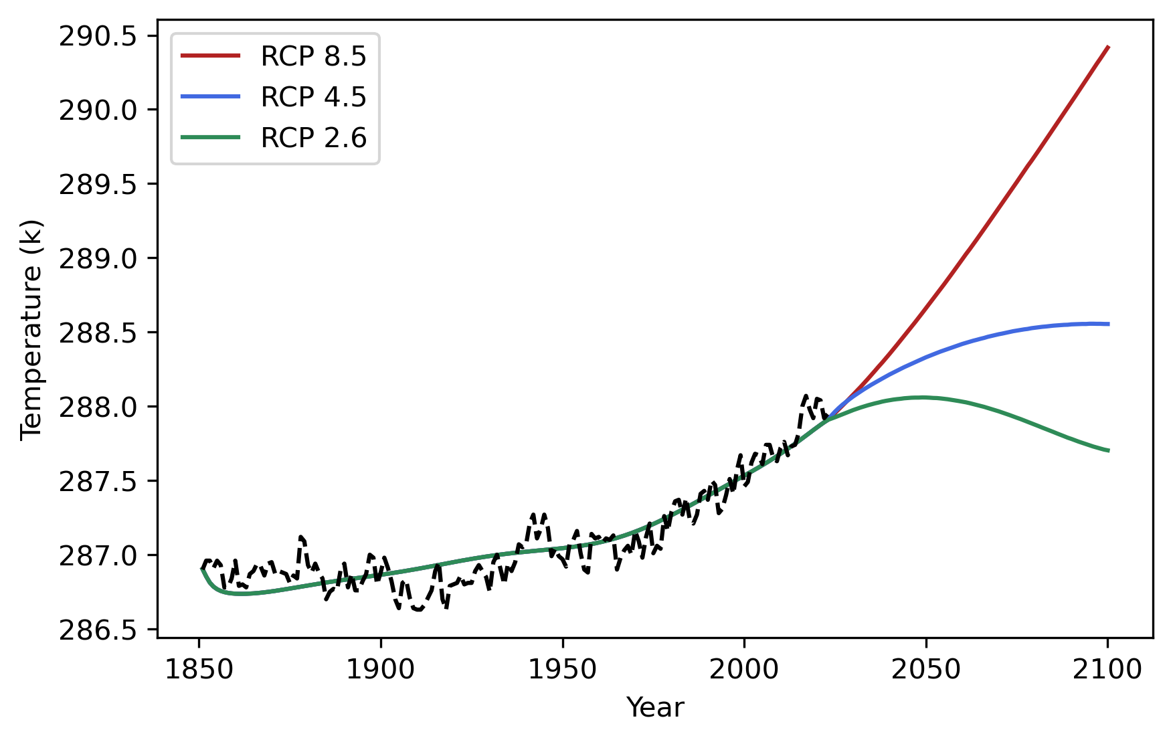
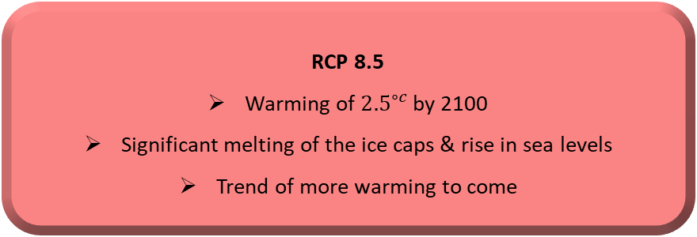
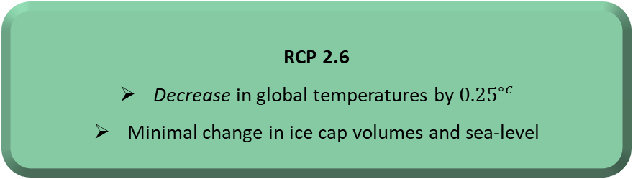
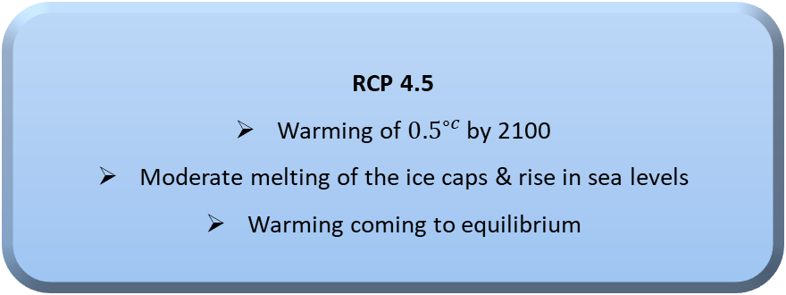
Temperature Forecasts
Global Temperature Forecasts into 2100
RCP 8.5
Warming of ${2.5}^{∘c}$ by 2100
Significant melting of the ice caps & rise in sea levels
Trend of more warming to come
RCP 4.5
Warming of ${0.5}^{∘c}$ by 2100
Moderate melting of the ice caps & rise in sea levels
Warming coming to equilibrium
RCP 2.6
Decrease in global temperatures by ${0.25}^{∘c}$
Minimal change in ice cap volumes and sea-level

Slide 19
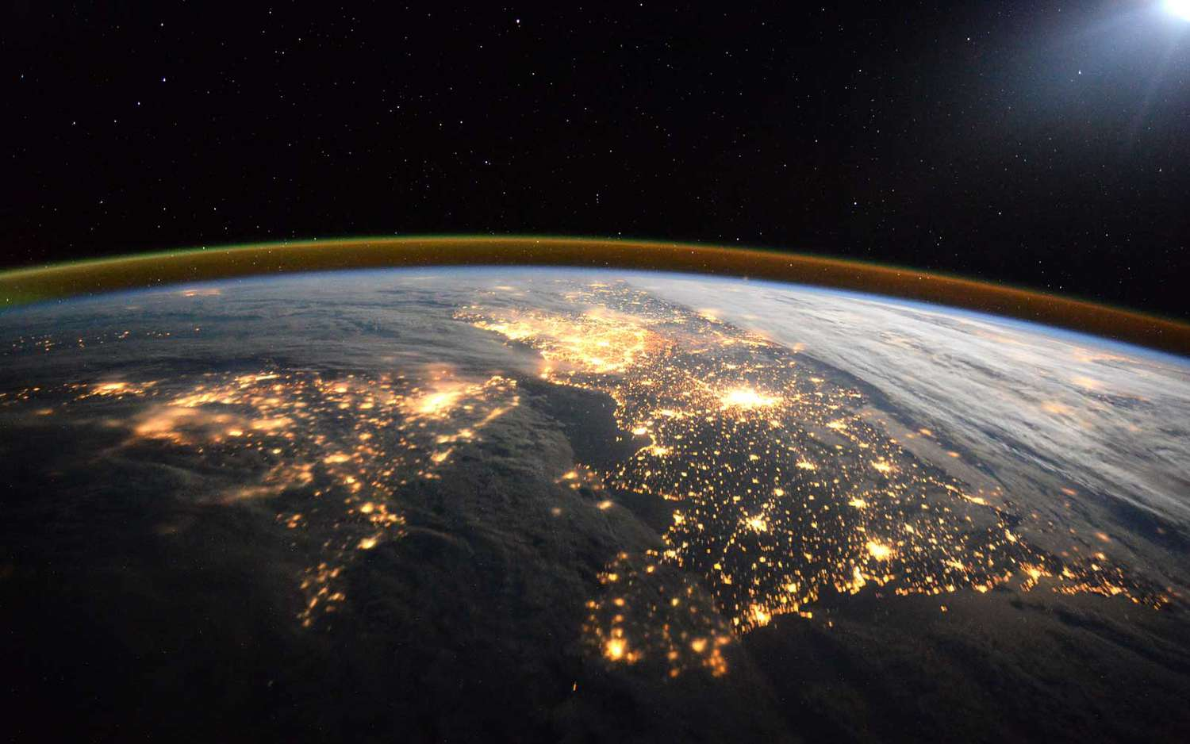
Next Steps
Model frequency of wildfires & droughts
Compare results to available research
Q&A
(ESA)

